Slide 1

Cloud Computing And databases

Slide 2
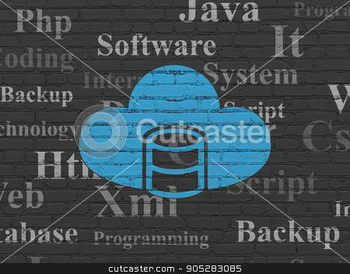
Cloud database
A cloud database is a type of database service that is built, deployed and delivered through a cloud platform.
Cloud databases typically run on a cloud computing platform

Slide 3
Cloud database
A distributed database that provides computing as a service is referred to the cloud database management system.
It provides web infrastructure for resources, software and information across the network. The use of cloud as a storage location helps to mine and compute database from any location.
The distributed storage solution is increasingly used by the different web application to scale up. The users can outsource the resource and services to the third party server using this solution.

Slide 4
Cloud database
A cloud database is a database service built and accessed through a cloud platform. It serves many of the same functions as a traditional database with the added flexibility of cloud computing. Users install software on a cloud infrastructure to implement the database.
Key features:
A database service built and accessed through a cloud platform
Enables enterprise users to host databases without buying dedicated hardware
Can be managed by the user or offered as a service and managed by a provider
Can support SQL (including MySQL) or NoSQL databases
Accessed through a web interface or vendor-provided API

Slide 5
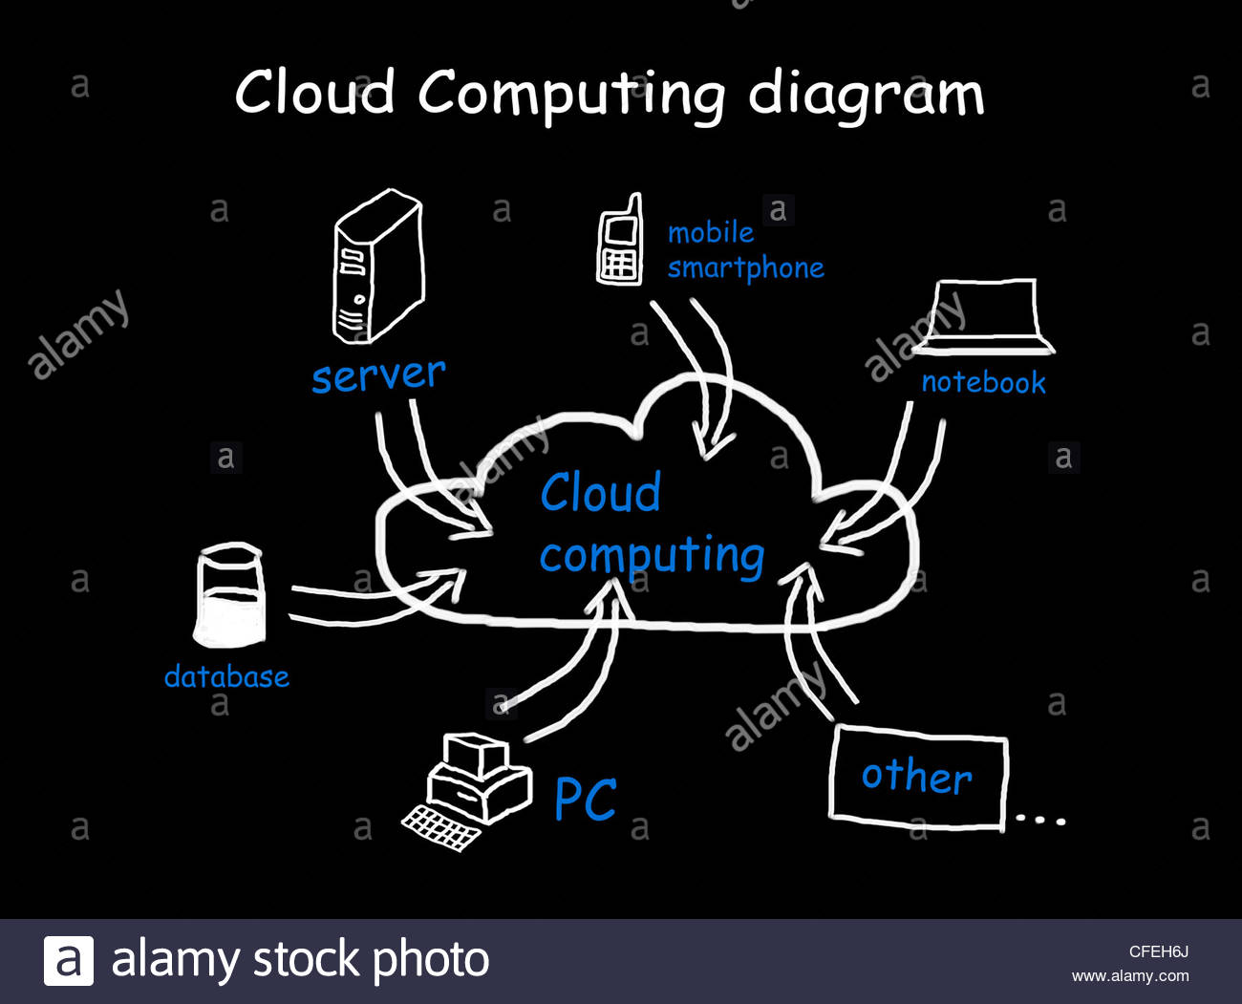
Cloud computing
Cloud computing is shared pools of configurable computer system resource that can be rapidly provisioned with minimal management effort.
It relies on sharing of resource to achive coherance and economies of scale ​

Slide 6
Third party clouds help organizations to focus on their core bussiness instead
The perks of cloud computing are:
Avoiding or minimazing up-front IT infrastructure cost
Allowing enterprises to get their applications up and runnging faster
Enableing IT teams to more rapidly adjust resource to meet fluctuatuing and unexpected demand

Slide 7
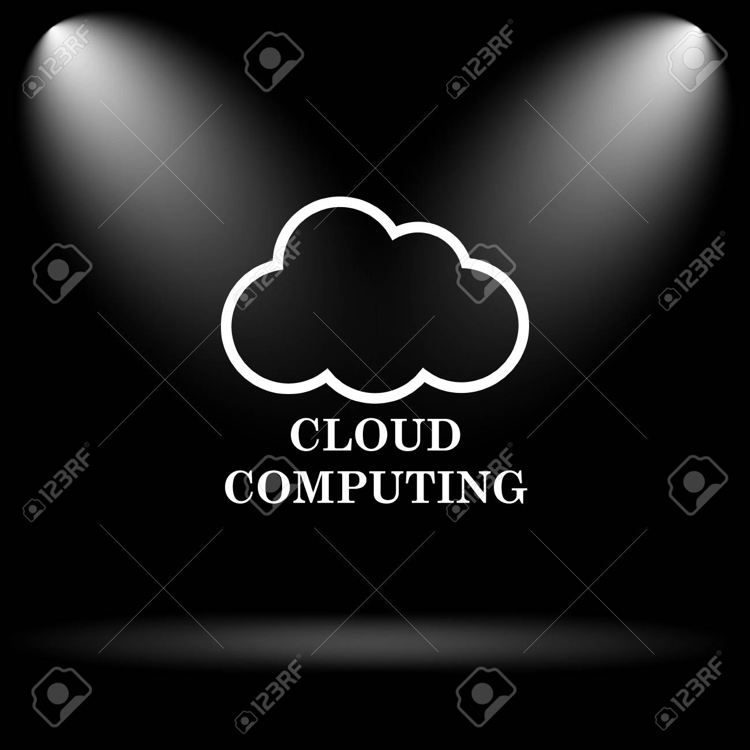
Usually cloud providers use a "pay-as-you-go" model
A lot of adoptions and improvements have led to the growth in cloud

Slide 8
cloud computing services
Generally, cloud computing services are categorized into three types.
1) Infrastructure as a Service (IaaS): This service provides the infrastructure like Servers, Operating Systems, Virtual Machines, Networks, and Storage on rent basis.
Eg: Amazon Web Service, Microsoft Azure
2) Platform as a Service (PaaS): This service is used in developing, testing and maintaining of software. PaaS is same as IaaS but also provides additional tools like DBMS and BI service.
Eg: Apprenda, Red Hat OpenShift
3) Software as a Service (SaaS): This service makes the users connect to the applications through the Internet on a subscription basis.
Eg: Google Applications, Salesforce

Slide 9
CLOUD DATABaSE Deployment models
There are 2 primary ways to run a database in a cloud:
Virtual machine image
Database as a service (DBaaS)

Slide 10
Virtual machine image
Cloud platforms allow users to purchase virtual-machine instances for a limited time
Users can upload their own machine image or use ready made machine images

Slide 11
Virtual machine image
Cloud platforms allow users to purchase virtual-machine instances for a limited time, and one can run a database on such virtual machines.
• Users can either upload their own machine image with a database installed on it, or use ready-made machine images that already include an optimized installation of a database

Slide 12
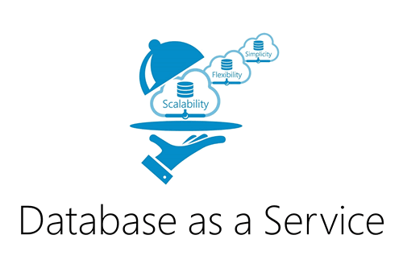
Database as a service (DBaas)
With this model, owners don't have to install and maintain the database themselves.
Instead the provider takes responsibility for installing and maintaining the database, while the owner gets apropriately charged

Slide 13
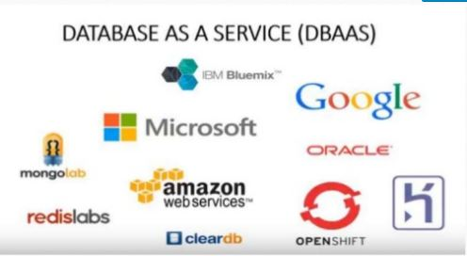

Slide 14
Data model
The design and development of typical systems utilize data management and relational databases as their key building blocks
Advanced queries expressed in SQL work well with relational databases
However relational database technology was not initialy designed or developed for use over distributed systems

Slide 15
Modern relational databases have shown poor performance on data-intensive systems, and so has risen the idea of utilizing NoSQL with database management systems
Within the NoSQL implemented storage, there are no requirements for fixed table schemes
NoSQL databases provide efficient horizontal scalability, good performance and ease of assembly into cloud applications
It is important to differentiate between relational cloud databases as to opposed non-relational or NoSQL databases

Slide 16
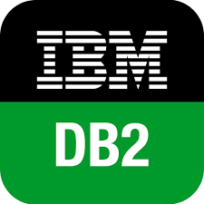
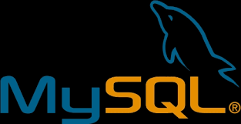
SQL databases
Or relational databases, can either run in the cloud or a virtual machine as a service
While they are easily vertically scalable, horizonatal scalability poses a challenge

Slide 17
NoSql databases
Are another type of database which can run in the cloud.
They are built to service heavy read/write loads and can scale up and down easily
But most contemporary applications are built on a SQL data model so working with NoSQL can require complete rewrite of application code

Slide 18

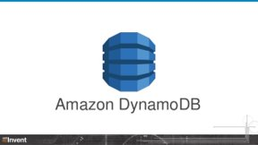
A multi model database provides a SQL interface to users and thus facilitates the usage of such databases for contemporary applications bulit around a SQL data model

Slide 19
Sql data model examples
Virtual machine deployment
DAtabase as a service
EDB Postgress advanced server
IBM DB2
MySQL
Amazon reletional database service
Clustrix DBaaS
Google could SQL

Slide 20
Nosql data model examples
Virtual machine deployment
DAtabase as a service
Apache Casandra
Clusterpoint database virtual box
CouchDB
Amazon dinamoDB
Azure document DB
Google cloud bigtable

Slide 21
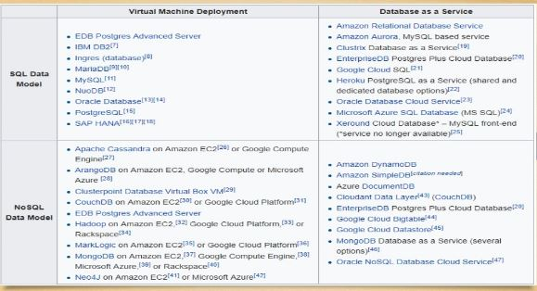

Slide 22
Architecture and common characteristics
Most database services offer web-based consoles, which the end user can use to provision and configure database instances.
Database services consist of a database-manager component, which controls the underlying database instances using a service API.
The service API is exposed to the end user, and permits users to perform maintenance and scaling operations on their database instances.
The service provider is responsible for installing, patching and updating the underlying software stack and ensuring the overall health and performance of the database.
There is typically a commitment for a certain level of high availability (e.g. 99.9% or 99.99%).

Slide 23
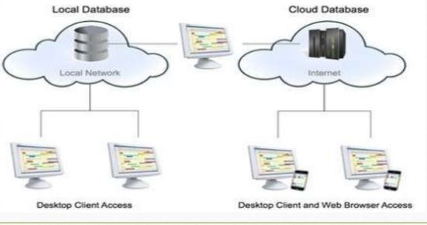

Slide 24
CHALLENGES TO CLOUD DATABASE
The implementation of cloud database has certain challenges in its implementation and its successful working. However, after all these challenges, the cloud database is becoming the best option for the companies. Below are some of the challenges to the cloud computing
1 Internet Speed:
The speed of data transfer in the data center is comparatively very high as compare to the speed of the internet that is used to access the data center. This is a barrier to the performance of the cloud database. This affects the performance of the cloud database (Bloor, 2011). The queries sent to the database are very fast, but the time taken to retrieve data from data center depends on the speed of the internet. The solution to this challenge is that to have faster speed cables, but that will cost very high and the motive of having a cloud database will waste

Slide 25
2) Query and Transactional Workloads:
There is a major difference between the query workload and the transaction work load. When we talk about the transactional workload, we can get an estimate about the time that will be required while on the other hand, we cannot estimate about the time of query workload. In query workload, it depends on the number of queries, and it is not known how many users will be there who will be making queries to the database
3) Multi-Tenancy
There may be a database and a workload that needs to be handled, but the main thing to ponder over is that what is the best way to get the maximum perform from the given machine. In this regard, it is important that the number of machines should be lesser and the efficiency should not decrease. The system should be able to understand the number of hardware resources that are required for each of the workload. The better idea is to use the same database server on different machines that will increase the performance as well

Slide 26
4) High Security
Security is an important concern particularly when you run your databases on in-house servers. It is necessary to make sure your database has an updated kernel and other important software so that you can fight with the digital threats. It is easy to do, but most companies don’t do it in a right way. Cloud can secure your data. So leave databases to your cloud service provider, and get a peace of mind.
5) Scalability
If we compare to traditional databases, cloud-hosted databases are flexible, cheap, and effective. To scale along any dimension needs adding or subtracting nodes from a group to change the storage capacity and also I/O operations/ second. To perform this operation, you require to redistribute copies of the data and deliver it between nodes

Slide 27
Advantages of Cloud Databases
Scalability: One of the key features of cloud-hosted databases, scalability lets you adjust your operations upwards or downwards as your IT requirements change. Scaling can be done quickly, cheaply, and efficiently, so even small businesses can find value in using the cloud.
Location Independence: Free yourself of the ball and chain! No physical limitations related to server location and storage means that wherever the end user may be, the database is right there, too. Data storage can now be done in an independent location, allowing easy access to information from every corner of the globe. All that readily available data means simpler than ever collaboration, as users can easily access, view and modify shared files.
Lighter Administrative Burden: Cloud-hosted databases don’t eliminate the role of a database administrator, but it can get rid of many features that typically consume a DBA’s time, allowing them to focus on more important tasks.
Prepare for disaster:As the arrival of disaster is uncertain, it is important for every business to have a reliable backup that can help in emergency time. The answer to this is online database management that gives integrated cloud backup for off-site storage, robust backup solutions to secure physical and virtual systems, and automated physical to virtual backup conversion during the time of server failover.
Elimination of physical infrastructure: The cloud computing provider takes care of maintenance and availability of servers, storage, and other infrastructure. The organization that has the database are authorized to support and maintain the database software along with its contents.

Slide 28
The other advantage of using a cloud database is that it saves a lot of money. The company does not need to invest money in setting up their own data centers and then managing it by hiring extra staff for this purpose. Moreover, after setting up a data center, the company will need to buy the softwares as well and their maintenance is also required.
The cloud database service providers of DBaaS providers also make the customer free from the tensions of making any immediate changes in the database. On the other hand, the cloud database providers also offer scalability on the peak times that does not let the performance of the company go down.
Cloud computing has given the freedom to access the information from anywhere without any boundaries of getting to your personal computer at home. This makes it a very powerful technology and the companies prefer it as the customers, employees or the authorities of the companies can get the formation they want from anywhere at any time.
There are many other benefits of cloud database as well, that makes it the best option available to the larger organizations and companies who need to hold terabytes of data. The cloud database makes the availability of data possible anytime from anywhere

Slide 29
DISADVANTAGES OF CLOUD DATABASES
Data Breaches: It’s every CEO’s worst nightmare — the company’s data falls into the hands of its competitors. Cloud computing has brought with it new paths for putting data at risk, including cyber attacks. There are ways, of course, to prevent data breaches. But while encryption protects your data, you lose the data if you lose the encryption key. The solution is to make multiple data copies, but the more copies that exist, the more the data is exposed to breaches.
Data Loss: Fear of seeing valuable data disappear into the unknown leaves many people skeptical of cloud services. For them, loss of the encryption key, a malicious hack, or a careless cloud service provider isn’t worth the advantages.
Inflexibility: Many non-cloud database issues can only be solved with a patch, upgrade, or configuration setting, and the locked-down nature of a cloud database may prevent you from using these solutions.

Slide 30
The companies have to pay for the usage of the cloud database as per decided. Every time the data is transferred from the database, the company will have to pay each time. If the traffic of the company for transferring data with the database is high then the company may be paying than its expectations.
The other disadvantage of using a cloud database is that, we do not have a full control over the server where our database is being held. We do not have the control over the softwares installed on those computers. You cannot do anything to make the security of cloud database strong. The client will have to rely on the provider only. The security issues can be a big problem for the companies.
The data you have hosted on the cloud database is totally dependent on the service provider. The data and information about a company are the most important asset for the organization. The organizations cannot afford to lose its information about its customers and company policies. If the information is given in the wrong hands then the company or the organization may face heavy losses.
As there are masses of data hosted on the cloud database so it is very difficult to transfer that data to your computer. For this purpose, internet speed must be high. On the other hand, the traditional database can transfer data at a very high speed.
If the client wants to switch database from one service provider to new one, then he may face problems. The reason is that each service provides use their own methods and techniques for storing data. The organization must be very careful about the selection of DBaaS provider.
In case of cloud database, the data is to be fetched via internet, so if the server is down, then it may cause inability to access the data from the server. This causes huge losses when the information is not available when needed

Slide 31
Cloud Database service Providers
1. Amazon Web Services
The key services of AWS are:
o Amazon RDS — for relational databases
o Amazon Redshift — As quick fully-managed, petabyte-scale data warehouse.
o Amazon DynamoDB — With its managed NoSQL database services
o Amazon ElastiCache — Providing in-memory caching service.
2. Microsoft Azure SQL Database
Azure is also pretty much like Amazon and offers both SQL and NoSQL databases. Advantages of having Azure include scalability with absolutely no downtime, built-in security protections, automated tuning, multi-tenancy capabilities and support for development tools
3. Rackspace
Databases offered by Rackspace come in managed or hosted cloud databases. Rackspace provides high performance and incorporates a SAN storage network based on the OpenStack platform.

Slide 32
4. Cloud SQL by Google
As it can manage both MySQL and PostgreSQL databases, Cloud SQL with its relational databases and a Big Query analysis tool can easily run queries on cloud-based data for Google Cloud Platform.
It is easy to set up, manage, maintain and administer. Cloud SQL is the answer for developers looking for the best option to save time consuming tasks like applying patches and updates, manage backups and a lot more.
5. SAP
SAP, the giant in offering enterprise software, now offers a cloud database platform called HANA for complementing the on-premise database-related tools of an organization. One of the major database tools complemented by SAP HANA includes Sybase, and this tool is available in the AWS cloud.
6.Oracle Database as a Service
Enterprise developers are also aware of the capabilities of Oracle databases in data centers. Keeping this in mind, Oracle has released its database technology on an SaaS basis. It can support any size workload, right from development to testing, and still provide high-level security encryption spanning multiple layers.

